Slide 1
Post-Negotiation
Compiled by Dr. Renu Girotra

Slide 2
What to evaluate:
Personal performance (Personal Excellence)
Decision (Termination/ Outcome- Reasons)
Desired/ compromised Outcome?
Alternatives were carefully assessed?
Preparation
Assessment of self, others
Ethics/ Trust
Long-term impact (economic, social)
Relations
Tactics used/ handled
Areas of improvement
* Refer to Questionnaire shared in the chapter in T2.

Slide 3
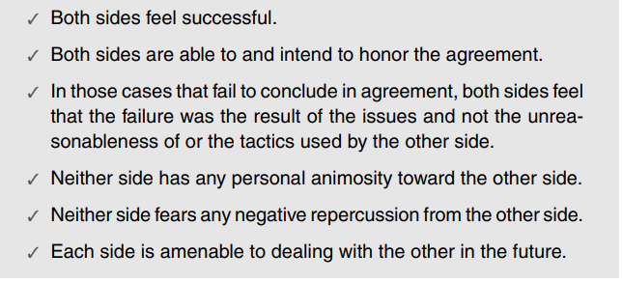
Some Indicia of a Successful Win-Win Negotiation

Slide 4
Common mistakes in negotiation
Failing to follow/ observe the basic rules of negotiation
Not able to strategize disclosure of information
overestimate your weaknesses and/or to underestimate the weaknesses/ strengths2 of your counterpart
likewise, overestimating / overconfident of self
to hold to a fixed plan in the face of new or additional information
set your goal too optimistically or too pessimistically
set goals or take positions without reasoning and support that can be (and are) communicated to the other side
to make a counterproposal to an unreasonable or unsupported offer from the other side. You will be negotiating against yourself!
to let the other side know that you are under a time deadline?
jump at the first offer from the other side

Slide 5
Common mistakes in negotiation
to focus on what the other party gets. The other party’s gain is not your loss! Focus on your goals.
to respond to something for which you are not prepared
Not saying no in an acceptable manner is the final common mistake. You should not be critical or offensive, and you should not shift blame. Be firm, but give explanations for your rejections
Failing to understand the difference in:
passivity (Failing to try to make your opinions and desires known),
aggression (Passive aggressive behavior- one acts out. Fears, frustration, and anger are expressed in indirect actions such as sarcasm and other signals; Hostile-aggressive behavior is not so subtle. It is striking out with direct impolite or belittling comments)
assertion (own your feelings and desires and to express them in non-offensive ways. Being assertive is to attack the issues rather than the people)

Slide 6
General Rules for Effective Negotiation
Do not consider negotiation as a game
Be prepared
Know relevant aspects of your own personality and behavioral tendencies as well as your needs, goals, and power
Perceive and assess relevant aspects of your counterpart’s personality, needs, power, and behavior
Practice effective listening, speaking, filtering, and watching
Never lose control of yourself
Always look for common ground and common goals
Know when to continue and know when to walk away
Maintain your personal integrity, and trust yourself
Never negotiate with someone who has no authority to commit
Confirm the status of the negotiation
Put it in writing as soon as possible

Slide 7
References
Negotiation by Roy J Lewicki, Bruce Barry & David M Saunders , 6th edition
Conflict Management: A practical guide to developing Negotiation Strategies by Budjac Corvette, Barbara A , first edition

Slide 8
THANK YOU

